Slide 1
Predicting music popularity on Spotify
Leo Evancie
Leo Evancie, 2021

Slide 2

The Problem
Spotify calculates popularity for each track based on engagement
How to predict popularity for new music?
Implications for content optimization and choosing new music to promote on the platform
Leo Evancie, 2021

Slide 3
The Solution
Lower track numbers more popular
Singles more popular than tracks from album
Higher danceability more popular
Medium energy popular; very low or high energy less so
Modest cluster of high instrumentalness with low popularity
86% of explicit tracks popular
89% of tracks with guest artist popular
Duration important to popularity, peaking around 200 seconds
Standard time signature popular
Classification model: ‘popular’ vs. ‘not popular’
Trained on 10,000 tracks spanning 10 years
Model generalizes well to new music and generates predictions fast
Key predictor variables:
Leo Evancie, 2021

Slide 4
The Approach
Collect and wrangle data from Spotify API
1
Explore data for trends and prepare for machine learning
2
Train a model to predict popularity of new music
3
Leo Evancie, 2021

Slide 5






1. Data wrangling
Leo Evancie, 2021

Slide 6
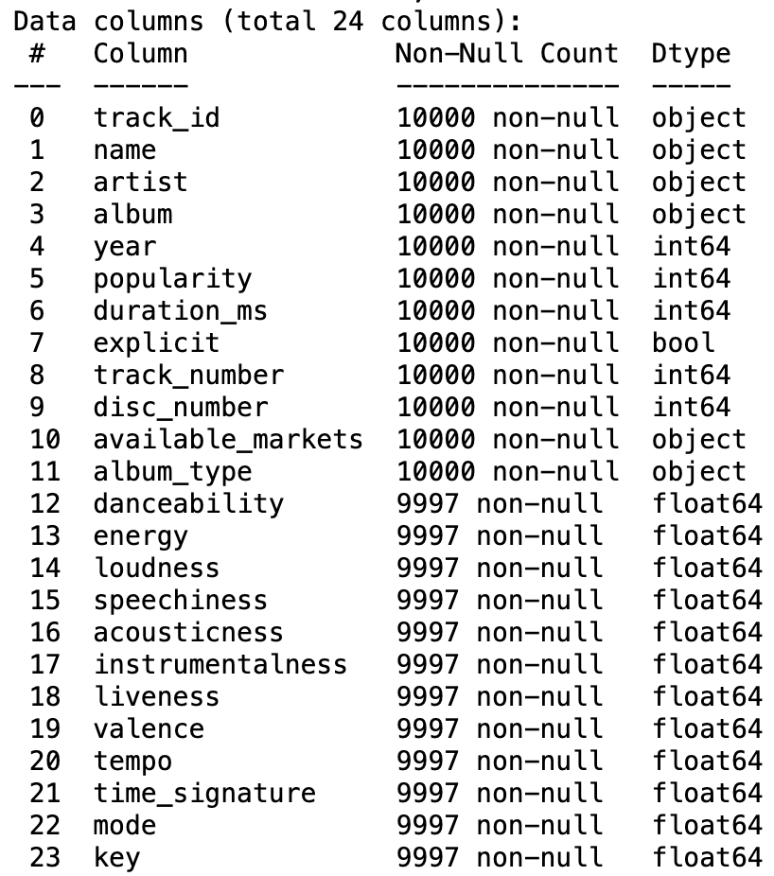
Dataset
Spotipy library, built to engage with Spotify API
“Search” endpoint
track_id, name…
“Tracks” endpoint
danceability, energy…
Leo Evancie, 2021

Slide 7
Dataset
Spotipy library, built to engage with Spotify API
“Search” endpoint
track_id, name…
“Tracks” endpoint
danceability, energy…
Leo Evancie, 2021

Slide 8
Dataset
Spotipy library, built to engage with Spotify API
“Search” endpoint
track_id, name…
“Tracks” endpoint
danceability, energy…
Leo Evancie, 2021

Slide 9

2. Exploratory data analysis
Leo Evancie, 2021

Slide 10
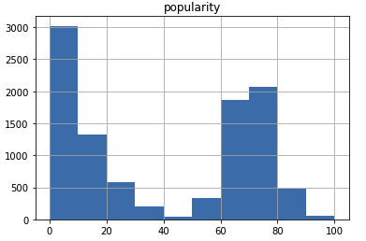
Target inspection
Popularity listed as 0 to 100
Bimodal distribution
Binary classification; greater than or equal to 50 -> “popular”
Leo Evancie, 2021

Slide 11
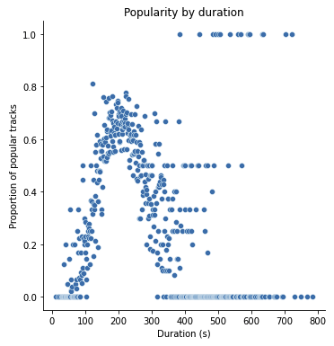
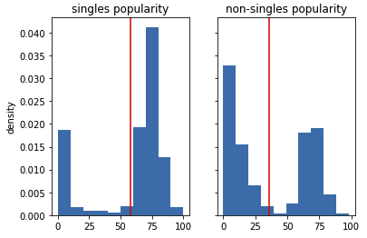
Feature inspection
Note: Figures reflect integer popularity values, prior to binary recoding
Leo Evancie, 2021

Slide 12

3. Predictive modeling
Leo Evancie, 2021

Slide 13
Model candidates
ensembles
Logistic regression
K-nearest neighbors
Random forest classifier
Gradient boosting classifier
Leo Evancie, 2021

Slide 14
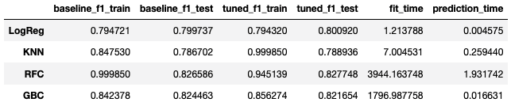
Model comparison
Leo Evancie, 2021

Slide 15

Conclusions and next steps
Gradient boosting classifier performed well, predicted quickly, and generalized better
Should tease apart the role of genre
API constraints led to decisions about how to collect tracks; a different search approach could yield similar-sized dataset comprised of all newer music
Potential for further feature engineering and parameter tuning
Useful for new users and/or new music; different approach for recommender system
Leo Evancie, 2021

